Slide 1

Exploring Product Reviews with Roberta's Sentiment Analysis
Team Members:
Srinivas Makkena
Naga Vamsi Krishna Jammalmadaka

Slide 2
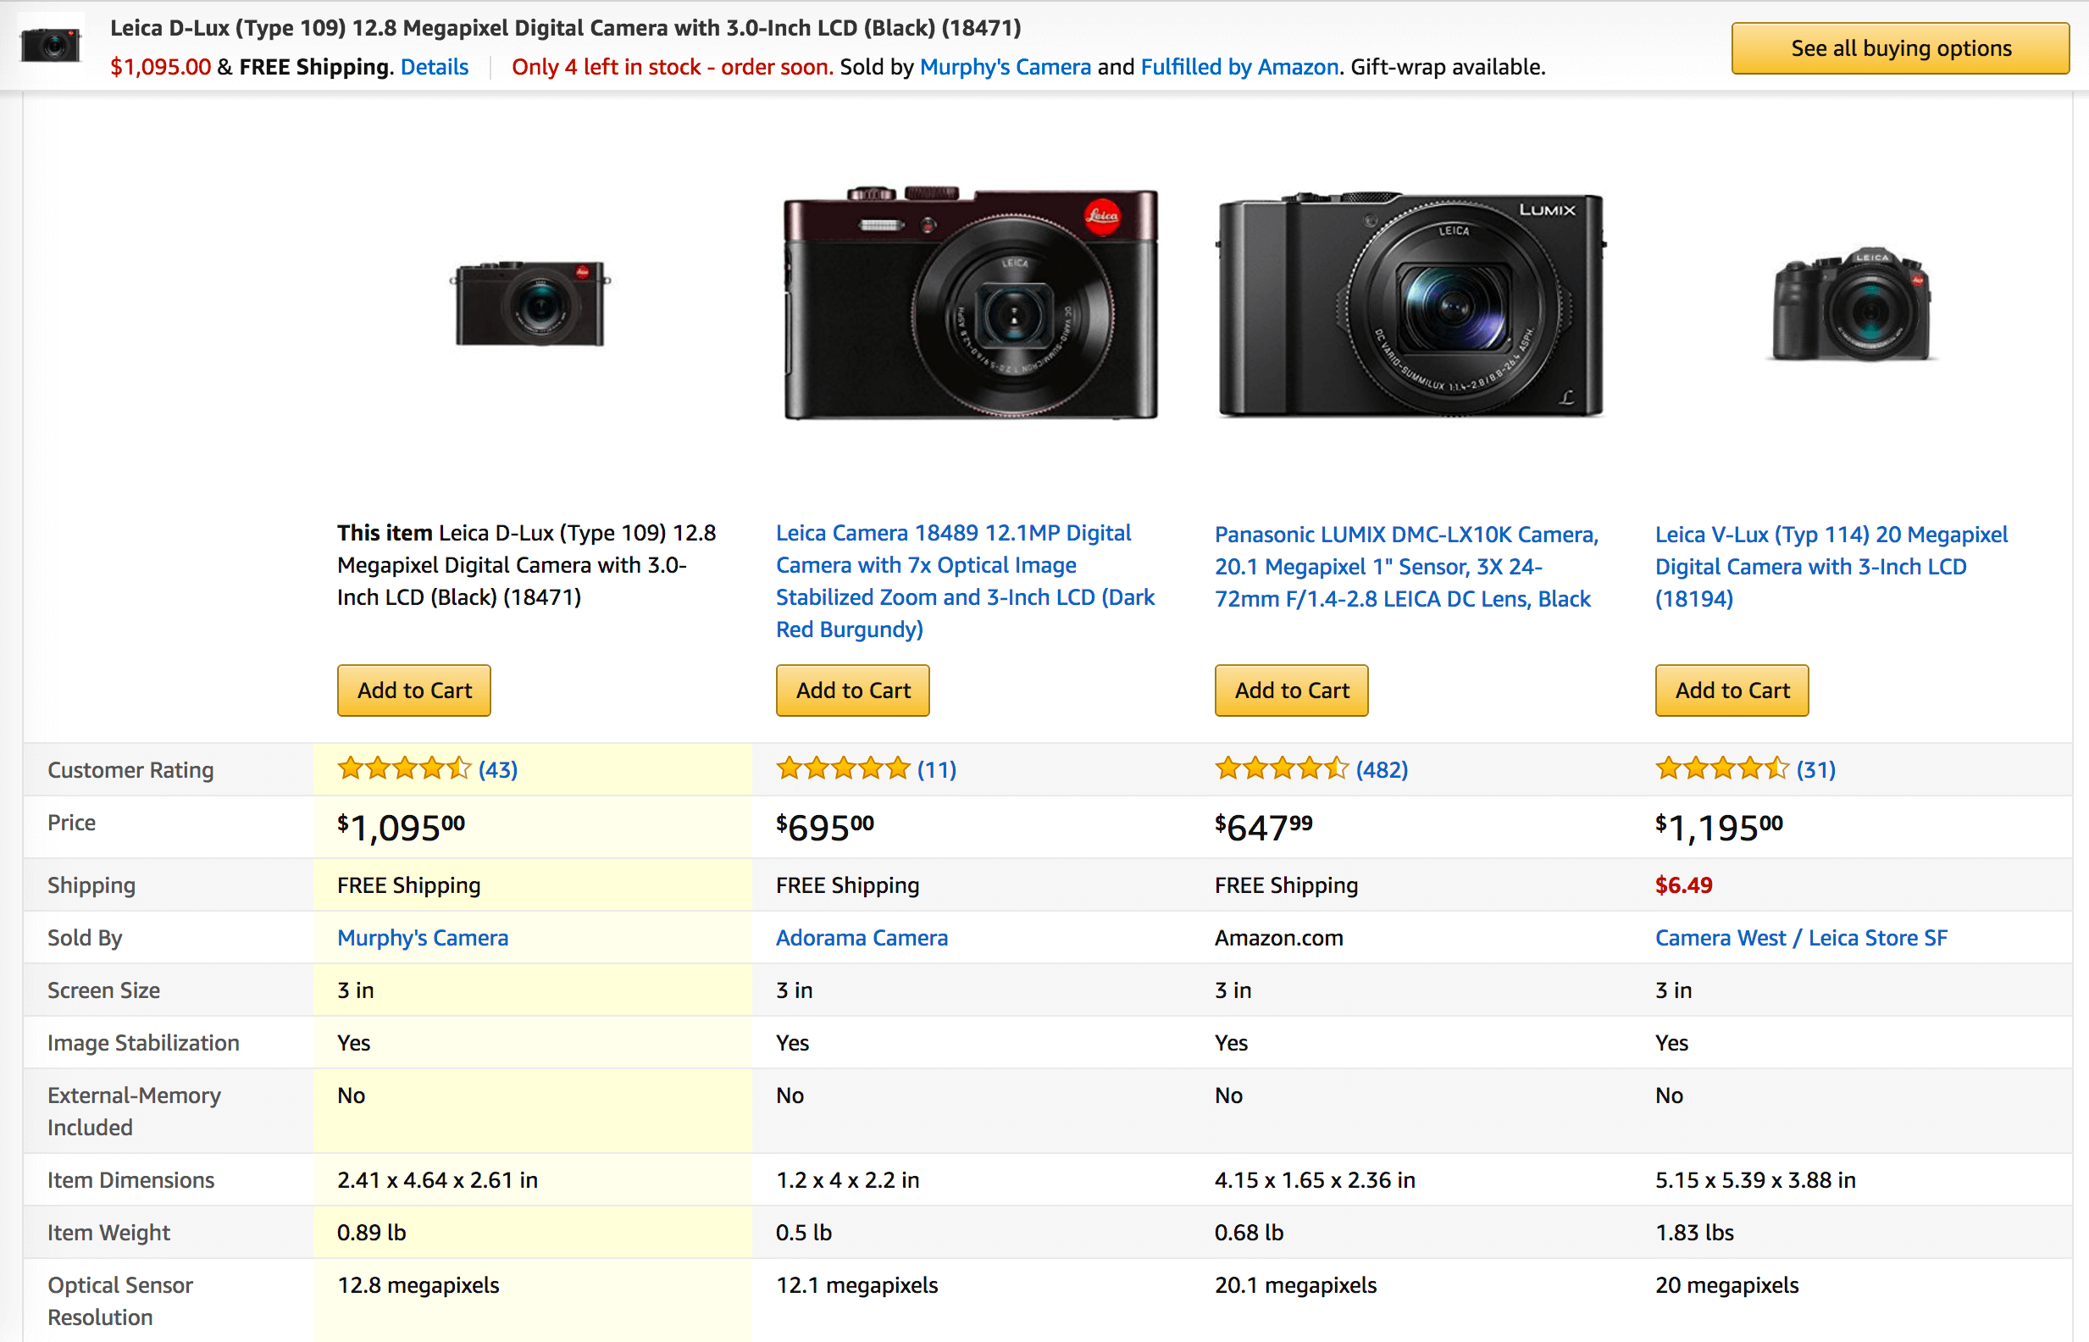
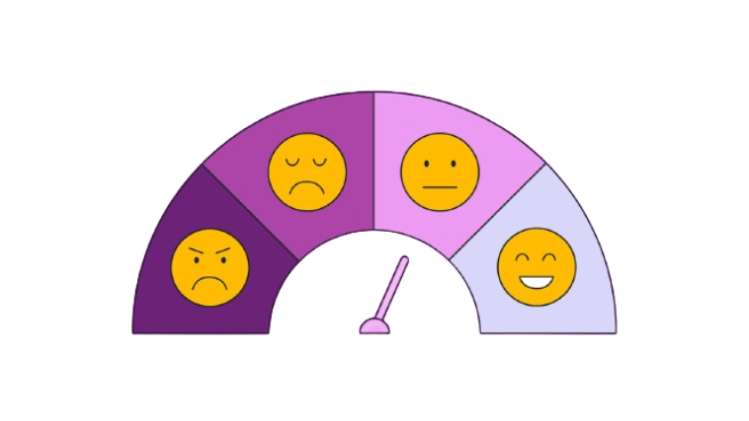

Comparing products by analyzing sentiment of reviews
Comparing the products by performing sentimental analysis
on the reviews of products from amazon.

Slide 3
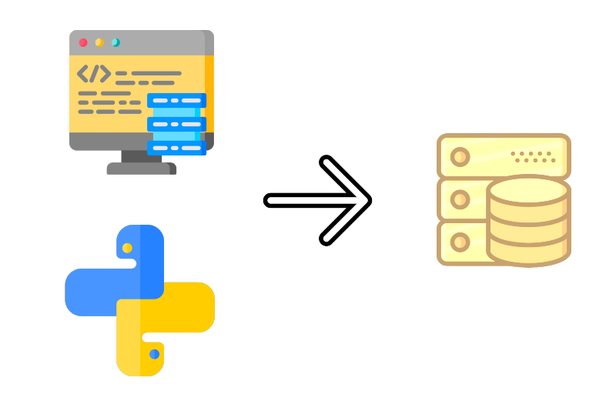
Where we got the data from?
Used pyppeteer(headless browser) library to scrape
the data from amazon review pages along with rating,
username and other details of a review and saved them all in a csv file.

Slide 4

Algorithm used for sentimental analysis?
ROBERTA (Robustly optimized BERT approach)
BERT (Bidirectional Encoder Representations from Transformers), is a pre-trained natural language processing (NLP) model developed by Google. It represents a significant advancement in the field of NLP, particularly in understanding the contextual meanings of words within sentences.
ROBERTA an optimized version of the BERT (Bidirectional Encoder Representations from Transformers) model developed by researchers at Facebook AI, aimed at improving its performance through modifications to the training procedure and hyperparameters.

Slide 5
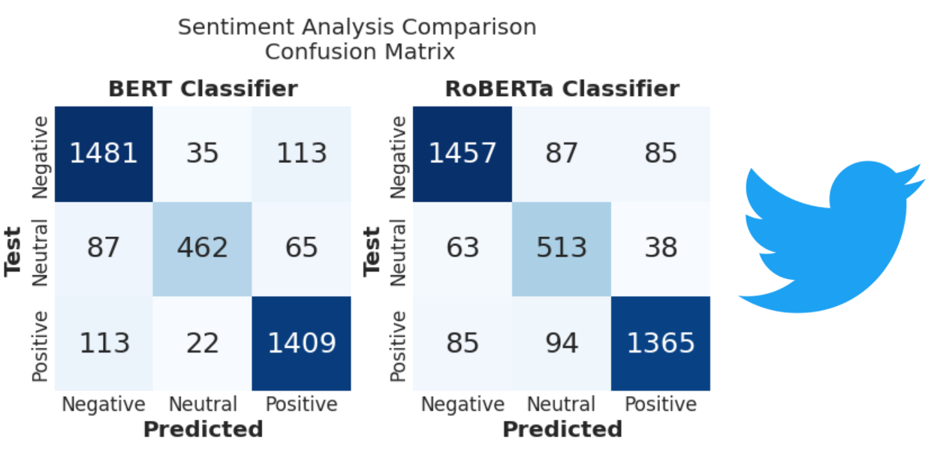
BERT VS ROBERTA
Eg. From https://www.kaggle.com/code/ludovicocuoghi/twitter-sentiment-analysis-with-bert-vs-roberta

Slide 6

Where we got the model from?
Hugging face – Transformer
Hugging Face provides an open-source platform and a wide range of tools and resources that make it easier for researchers, developers, and practitioners to work with transformer models like BERT. They offer pre-trained versions of BERT and other transformer-based models, along with easy-to-use libraries like Transformers, Tokenizers, and Datasets.

Slide 7
Libraries used :
beautifulsoup4 4.12.3
Flask 3.0.2
pyppeteer 2.0.0
Requests 2.31.0
sumy 0.11.0
transformers 4.37.2

Slide 8
Code
SENTIMENT FINDER
roberta = "cardiffnlp/twitter-roberta-base-sentiment"
model = AutoModelForSequenceClassification.from_pretrained(roberta)
tokenizer = AutoTokenizer.from_pretrained(roberta)
def analyze_sentiment(review_text):
encoded_text = tokenizer(review_text, return_tensors='pt’,
padding='max_length’, truncation=True, max_length=512)
output = model(**encoded_text)
scores = output[0][0].detach().numpy()
scores = softmax(scores)
sentiment = labels[scores.argmax()]
return sentiment, scores
SUMMARY GENERATOR
summarizer_lsa = LsaSummarizer()
parser = PlaintextParser.from_string(summary_text, Tokenizer("english"))
summary = ""
for sentence in summarizer_lsa(parser.document, 5):
summary += str(sentence)

Slide 9

Issues Faced:
Multiple pages of reviews and socket connection rejection while trying to read the reviews from amazon.
Input sentence length limit while analyzing sentiment
Require large computational power

Slide 10
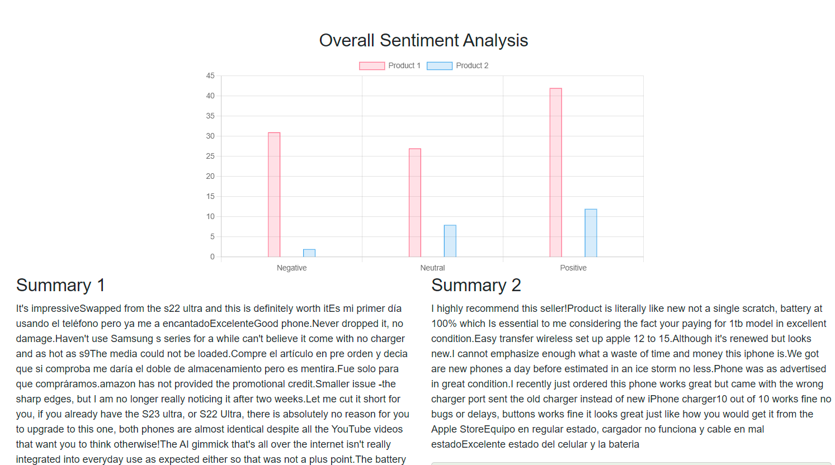
Result

Slide 11
References:
Huggingface for model
Extractive Text Summarization Techniques With sumy
Chat gpt for fixing issues with roberta model
Source code: https://github.com/srinivasmakkena/5443_NLP

Slide 12

Thanks!
Any questions?

